Slide 1

Community Schools:
An Essential Urban Education Strategy
ECGRA Grant Update
September 20, 2018

Slide 2
2018 Community Challenges
Educational achievement/attainment
Youth violence
Community disorganization
Poverty
Economic development
Resource alignment/collaboration
Coordination of service delivery

Slide 3
Erie’s Public Schools CS Pilot
School | Edison | McKinley | SVMS | East MS | Pfeiffer-Burleigh
Grade Levels | PreK-5 | PreK-5 | 6-8 | 6-8 | PreK-5
Corporate Partner | GE Transport. | LORD | Highmark | Hamot Health Foun | Erie Ins.
Lead Partner | Achieve. Cntr. | Edinboro U. | Gannon U. | Safe Harbor | Family Services
Principal | Kevin Harper | Dana Suppa | Tim Sabol | Diane Sutton | Karin Ryan
CSD | Tami Conway | Sonia Rios | Katrina Byrd | Jamilia Gates | Meghan Easter

Slide 4
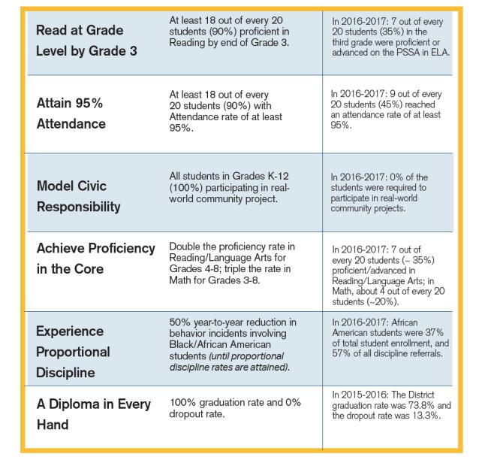
Erie’s Public Schools Strategic Plan

Slide 5
“Community Schools are a strategy for organizing the resources of the community around student success…”
– Pat Harvey, Former Superintendent St. Paul Public Schools

Slide 6
Pilot update:
CSD’s hired in January 2017
Data-driven school action plans completed for every community school in October 2017
Partnership agreement implemented in October 2017
Partnerships established with: BTW Center, MLK Center, JFK Center, Boys & Girls Club of Erie, YMCA, PSU Behrend, Second Harvest Food Bank, SSJ and many more
Strong backbone support and professional development provided by United Way of Erie County

Slide 7
Priority needs identified:
Kindergarten readiness
Physical, mental and behavioral health support
School attendance
Educational/capacity-building opportunities for adults
Family engagement
Managing student mobility
Expanded out-of-school time opportunities

Slide 8
ECGRA grant funds used to support:
Data collection in Erie’s Public Schools to ensure data sharing and collaboration
Professional development opportunities in Allentown/Bethlehem and National Conf.
Furniture/technology for a community school space in each school
Funds for Out of School Time Coordinators
Leverage for additional federal grants including Promise Neighborhoods and Full-Service CS grant

Slide 9
Questions/Comments

